Slide 1

Web Experiment

Slide 2
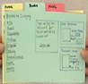
Design Thinking Review
Empathy human-centered design
Observe
Engage
Immerse
Empathy
Define design
Empathy findings
insights persona/ scenarios
point of view
Prototype
Empathize
Define
Evaluate
Ideate (Brainstorm)
be imaginative
diverse perspectives
Generate ideas
Iterate
Test
Test (experiment)
learn about your users
test to refine
Ideate
Prototype
Rapid Prototype (experiment)
learn quickly
Fail quickly and fail often
test people’s interaction
gain more insights
Inspection
Field Study
Lab Study
Surveys

Slide 3
Empirical
Lab Study
(Web) Analytics
Field Study / Observation
Survey / Interview
Obtrusive
Unobtrusive
Inspection
Model / Simulation
Theoretical
Notes:
Joseph E. McGrath (1995), Methodology Matters: Doing Research in the Behavioral and Social Sciences

Slide 4
Web Experiment
A/B Testing
Web UX Tools
Why do A/B Test?
Why not Hippo?
Examples of design choices
Qualtrics
Loop11
Maze
Designing Test
Different tests
What are control and treatment conditions?
How to decide on design choices?
Understanding test population
Web Analytics
Multivariate Test

Slide 5
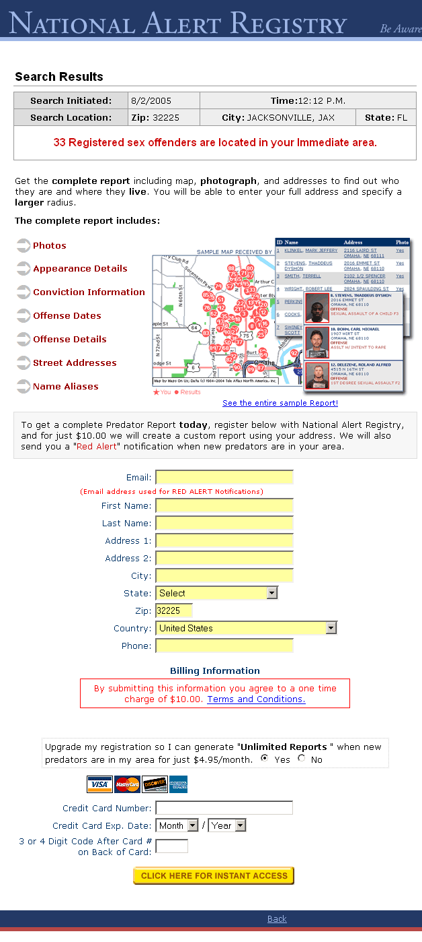
Version A
Notes:
http://www.alistapart.com/articles/designcancripple
However compelling the message, however great the copy, however strong the sales argument… the way a page is designed will have a dramatic impact on conversion rates, for better or for worse. Here are three versions of the same offer page I know, they won’t win any design awards. They weren’t intended to. But they are functional and familiar. A reader going to any one of these pages will be able to quickly figure out what the message is, and what they are being asked to do. Version A is the original.

Slide 6
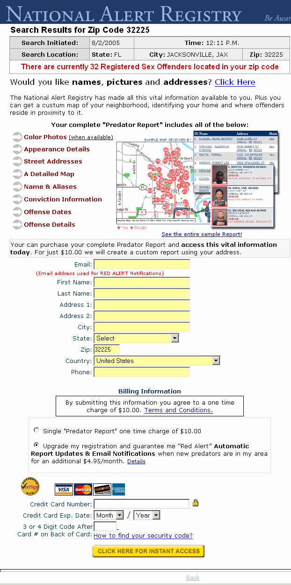
Version B
Notes:
Version B follows the same basic layout, but we made some minor copy changes.

Slide 7
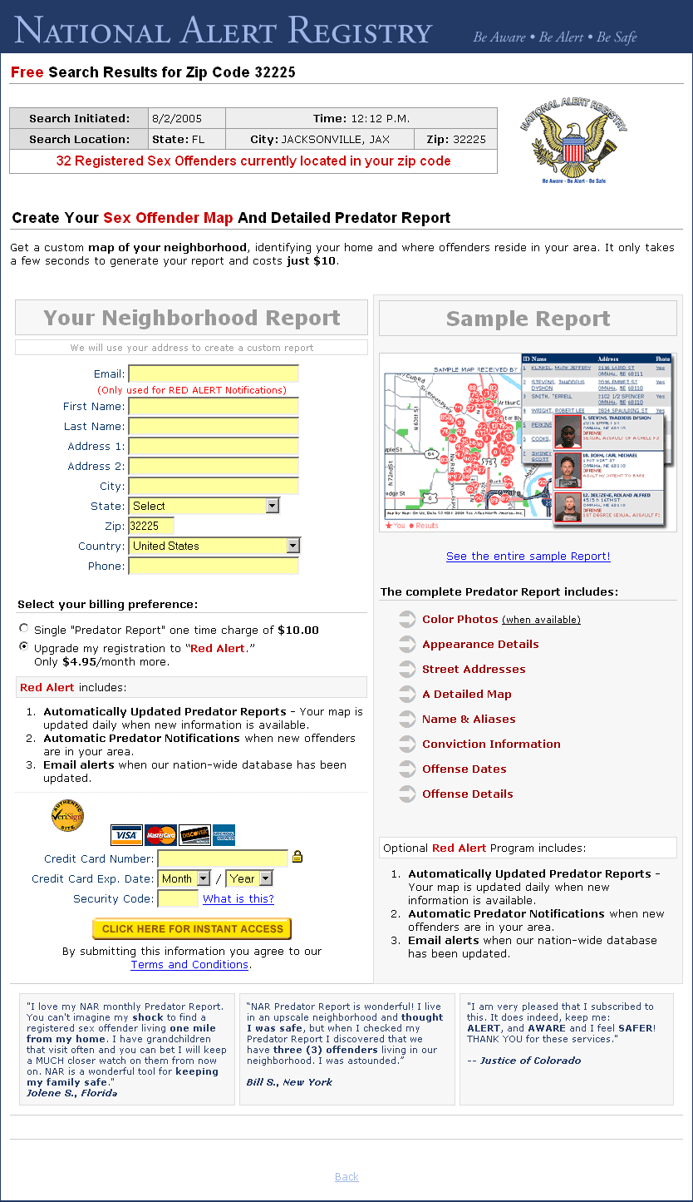
Version C
Notes:
In version C, we changed from a one-column format to two-column format. We wanted to test the impact of bringing more of the page content onto the first screen. Be honest with yourself and decide now whether B or C beat A, and by what percentage. I imagine you have some way of measuring the success of your site. Maybe it’s about sales. Maybe it’s based on readership. But one way or another, your site has a purpose. But I don’t think most designers truly understand the effect their design choices can have on achieving that purpose. And yes, I’m sure you do some usability testing. And that likely gives you some broad, if sometimes confusing insights into what’s working and what isn’t. But do you test different page designs?
By testing, I don’t mean asking a few folks around the office; I mean doing a live test that demonstrates—with hard figures—what site visitors actually do. Testing like that is a beautiful thing. There is no space for fancy arguments. An expert’s credentials and opinions mean squat. When you serve alternative versions, one after the other, and measure reader actions, you get the real deal. You get what is. But if you are serious about achieving your site’s purpose, and if testing can show you which version of a page does best, then where is the argument not to test?

Slide 8
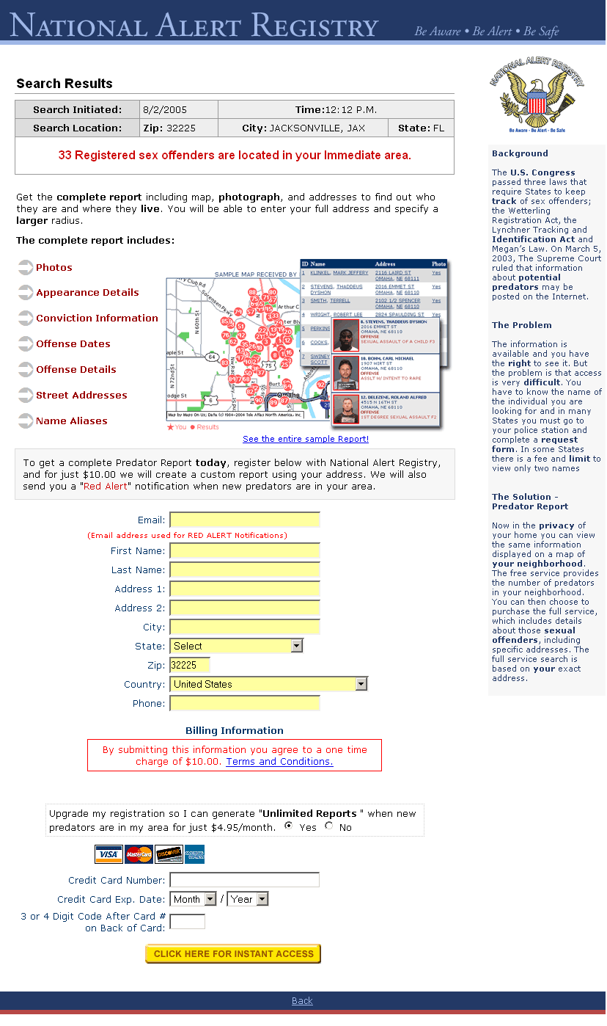
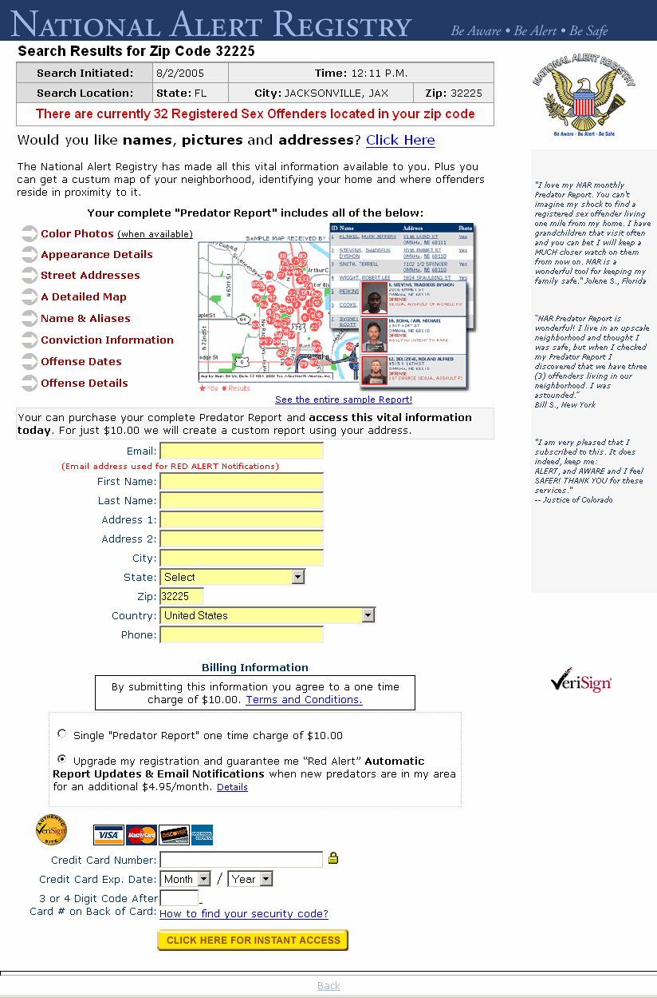
Version A
Version B
Version C
Notes:
This web site ran an experiment to see which web site would produce new sales. How big a difference would you expect between these sites?

Slide 9
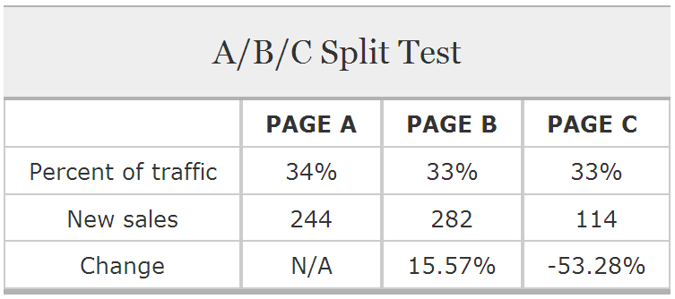
A
B
C
Small changes, big impact
Notes:
Why did C do so much worse? Maybe itʼs more confusing. It employs a “menu” pattern: two columns give customers the sense that there are two possible things to do here.
Whatʼs needed is a “funnel” pattern: guide the customer through the purchase process. A and B do this with a call to action, “would you like…? click here” at the top.
Source: http://www.alistapart.com/articles/designcancripple
http://en.wikipedia.org/wiki/A/B_testing
A/B testing or split testing compares the effectiveness of two versions of a web page, marketing email, or the like, in order to discover which has better response rate or better sales conversion rate.
A/B testing is a way to compare multiple versions of a single variable, for example by testing a subject's response to variant A against variant B, and determining which of the variants is more effective.
A/B testing can be used to determine the right price for the product, as this is perhaps one of the most difficult tasks when a new product or service is launched. A/B testing (especially valid for digital goods) is an excellent way to find out which price-point and offering maximize the total revenue.”

Slide 10
Design Choices can Cripple a Website
The position and color of the primary call to action
Position on the page of testimonials, if used
Whether linked elements are in text or as images
The amount of “white space” on a page, giving the content space to “breathe”
The position and prominence of the main heading
The number of columns used on the page
The number of visual elements competing for attention
The age, sex and appearance of someone in a photo
Cannot afford to guess
Dependent on the way it is presented
Test!
Notes:
http://www.alistapart.com/articles/designcancripple

Slide 11
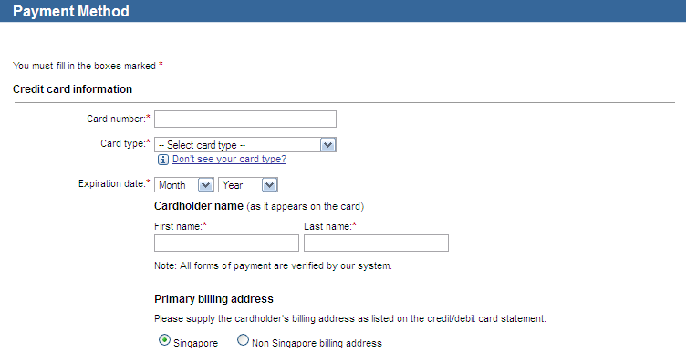
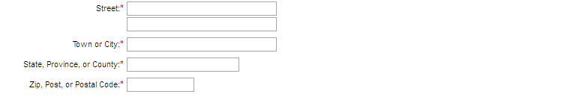
Expedia.com (Buy now but incomplete transaction)
Small changes, big impact
“Company” field used to be here
Removing increased profit by $12M
Company:
Data Analytics to build new services and change business process
Notes:
http://www.zdnet.com/expedia-on-how-one-extra-data-field-can-cost-12m-3040153863/
Expedia on how one extra data field can cost $12m
How to root out hidden profits with analytics...
Online travel firm Expedia has found that data analytics can deliver a multi-million dollar kick to a company's bottom line.
The company used SAS analytics to identify a single change to a web page that generated an overnight surge in sales, Expedia's VP of global analytics and optimisation Joe Megibow told the SAS Premier Business Leadership Series conference in Las Vegas last week.
Expedia analysts realised the site needed to be changed after investigating why many customers who clicked the 'Buy Now' button on the company's site did not complete the transaction.
"This is someone who was on our site, found the right location and hotel, put in all their billing and travel information and clicked the 'Buy Now' button," Megibow said.
"As far as leading indicators of purchase intent go, this is as good as it gets and yet we weren't taking the money.”
Analysts began examining and correlating information about these failed transactions to identify what traits they had in common.
The answer, it turns out, was quite simple: "We had an optional field on the site under 'Name', which was 'Company'," Megibow said.
"It confused some customers who filled out the 'Company' field with their bank name.”
After putting in their bank name, these customers then went on to enter the address of their bank, rather than their home address, in the address field.
"When it came to address verification to process the credit card, it failed because it was not the address of credit card holder," Megibow said.
One extra data field was costing Expedia $12m a year
"After we realised that we just went onto the site and deleted that field - overnight there was a step function [change], resulting in $12m of profit a year, simply by deleting a field.
"We have found 50 or 60 of these kinds of things by using analytics and paying attention to the customer.”

Slide 12
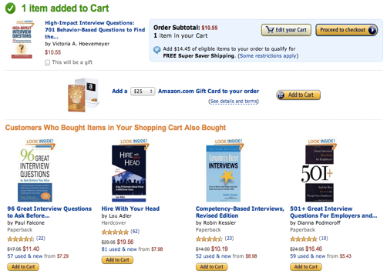
HIPPO vs. Customer opinion
Amazon shopping cart recommendations
Add an item to your shopping cart
Most sites just show the cart
Greg Linden
Personalized recommendations based on cart content
Good for impulse buys
Debate
Pro: Cross-sell more items (increase basket size)
Con: Distract from checking out (reduce conversion)
HiPPO (Highest Paid Person’s Opinion)
Senior Vice President said “stop the project”
Linden’s simple experiment: wildly successful
Measurement (customer test)
Data trumps intuition
Notes:
From http://glinden.blogspot.com/2006/04/early-amazon-shopping-cart.html
Kohavi et al., (2007) Practical Guide to Controlled Experiments on the Web: Listen to Your Customers not to the HiPPO
https://ai.stanford.edu/~ronnyk/2007GuideControlledExperiments.pdf

Slide 13
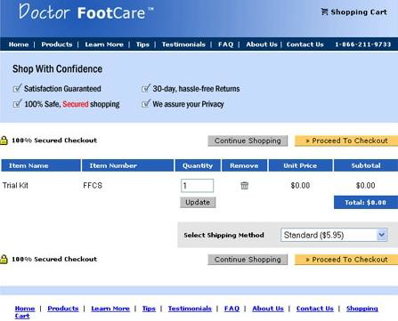
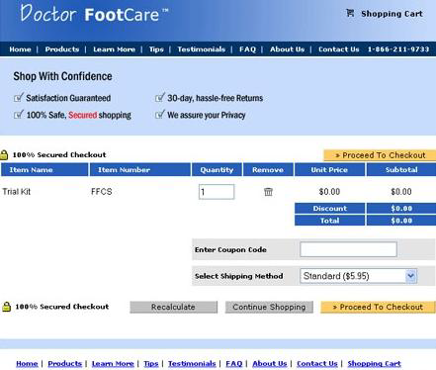
Checkout page
Checkout A
Checkout B
1
2
3
3
4
5
Avoid multiple changes
Small changes, big impact.
Data trumps intuition
“Upgrading” A to B lost 90% revenue
B without coupon code increased 6.5%
Notes:
Kohavi et al., (2007) Practical Guide to Controlled Experiments on the Web: Listen to Your Customers not to the HiPPO
https://ai.stanford.edu/~ronnyk/2007GuideControlledExperiments.pdf
The conversion rate is the percentage of visits to the website that include a purchase.
Which do you think has the higher conversion rate?
“In reality, the site "upgraded" from the A to B and lost 90% of their revenue. Most of the changes in the upgrade were positive, but the coupon code was the critical one: people started to think twice about whether they were paying too much because there are discount coupons out there that they do not have. By removing the discount code from the new version (B), conversion-rate increased 6.5% relative to the old version (A).”

Slide 14


20VC interview with Ed Baker & Brian Hale https://www.thetwentyminutevc.com/ed-baker/
Small changes, big impact. Facebook Japan “announce” vs “invite” 6:09-7:10
Data trumps intuition. Uber India no credit card ride 35:43-37:00
Small changes, big impact. Facebook ”Promote” to “Boost Post”
Notes:
https://www.thetwentyminutevc.com/ed-baker/
Example 1: Facebook Japan “announcement” instead of rude “invite”
Internationalization, Small changes, big impact. 6:09-7:10
Example 2: India Uber rider app add button “become a driver”
Needle mover, Small changes, big impact. 8:11-8:50
Example 3: Conversion rate
Facebook monthly active users, Uber monthly active rider, weekly trips
Northstar metric, 9:45-11:10
Example 4: India Uber no credit card to ride (cash)
Data trumps intuition, small experiment despite Uber CEO Travist 35:43-37:00
https://www.thetwentyminutevc.com/brian-hale/
https://www.youtube.com/shorts/trSXSbDuOVc
Example 5: “Promote” to “Boost Post”

Slide 15
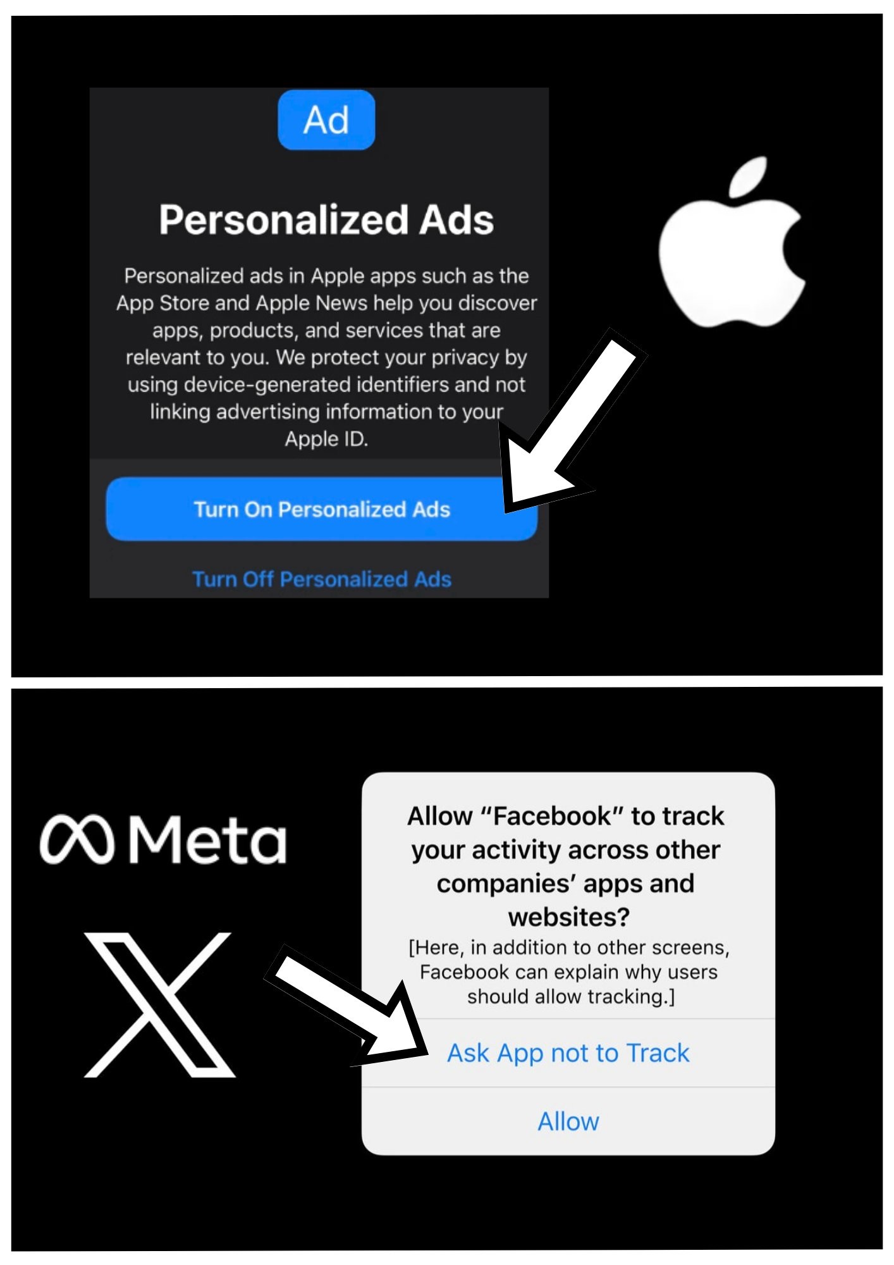
How you phrase it?
Tracking your data
Apple on tracking
Personalized Ads
Facebook and X on tracking
Ask App not to track
A/B Testing
Data trumps intuition
Small changes big impact

Slide 16
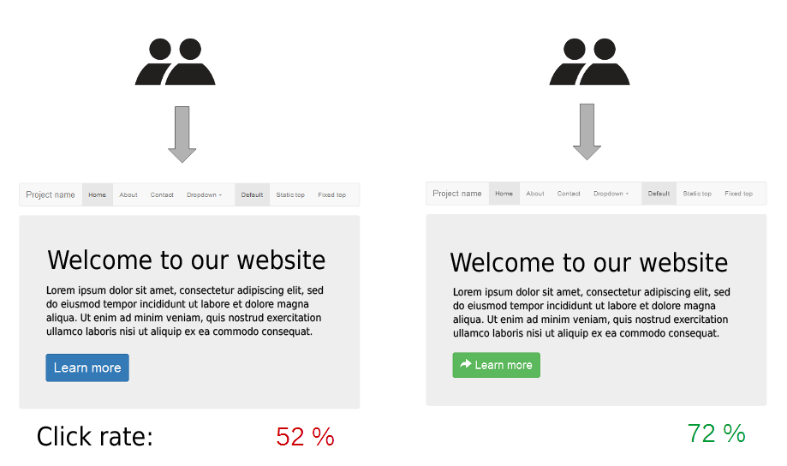
A/B Testing
To assess whether an alternative design is “good” or “bad,” evaluate difference and correlation through a randomized controlled experiment. The simplest form of the controlled experiment is called A/B testing.
Notes:
https://youtu.be/m000dSSXvDY
Nngroup A/B Testing 101
What is A/B testing, and why should you consider this method for measuring the business value of design changes?

Slide 17
A/B Testing
100% Sample Users
50% Users
50% Users
Control Condition:
Existing system
Treatment Condition: Alternative design
User interactions are analyzed, and compared
Suggest design decisions
Notes:
The basic idea behind this type of study is that participants can be part of the treatment group or the control group but cannot be part of both.
If more than one treatment is tested, a completely new group is required for each.
A between subjects design is a way of avoiding the carryover effects that can plague within subjects designs

Slide 18

Terminology
Control Condition (or a Placebo)
What you get if nothing changes
eg. the “current” version
Blue pill
Treatment Condition
What you get when you change something
eg. a modified version
Red pill
Notes:
https://youtu.be/g7JGe_ykB3I
Designing Experiments
Control and treatment groups
Randomization and replication (replicate by collecting sufficiently large sample)
Blocking (divide participants into blocks, evenly place in Control/Treatment) Avoiding confounding variable
A void psychological effect by Blinding (uninformed) and placebos (truly blind)

Slide 19

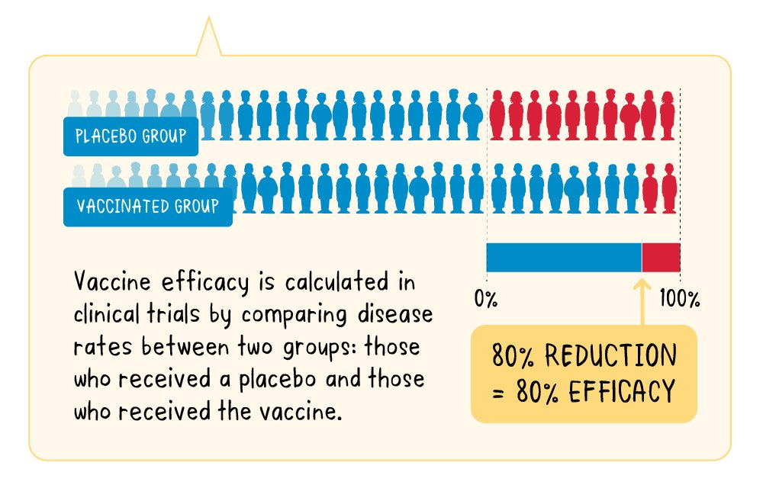
Vaccine Efficacy How the vaccine performs in controlled clinical trails?
Notes:
https://www.who.int/news-room/feature-stories/detail/vaccine-efficacy-effectiveness-and-protection
A vaccine’s efficacy is measured in a controlled clinical trial and is based on how many people who got vaccinated developed the ‘outcome of interest’ (usually disease) compared with how many people who got the placebo (dummy vaccine) developed the same outcome. Once the study is complete, the numbers of sick people in each group are compared, in order to calculate the relative risk of getting sick depending on whether or not the subjects received the vaccine. From this we get the efficacy – a measure of how much the vaccine lowered the risk of getting sick. If a vaccine has high efficacy, a lot fewer people in the group who received the vaccine got sick than the people in the group who received the placebo.

Slide 20
Web Experiment
A/B Testing
Web UX Tools
Why do A/B Test?
Why not Hippo?
Examples of design choices
Qualtrics
Loop11
Maze
Designing Test
Different tests
What are control and treatment conditions?
How to decide on design choices?
Understanding test population
Web Analytics
Multivariate Test

Slide 21
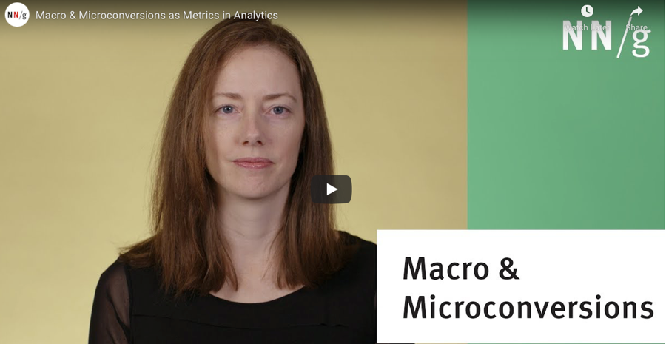
How to get Valuable Insights?
What kinds of behavioral information would be useful? (Success metrics/Goal)
Conversion rate—the percentage of users who take a desired action (e.g., the rate of users who buy items on an ecommerce website)
Or completion of a task
Macro & Micro Conversions https://youtu.be/oZzM2GgkZJU
Macro is the main success metric and could be infrequent
Micro is the more frequent that leads to the success metric
Total time for one shopping transaction or time on each web page
Notes:
https://youtu.be/oZzM2GgkZJU
NNgroup Macro & Microconversions as Metrics in Analytics
https://www.nngroup.com/articles/micro-conversions/
Not every design and content change generates immediate or significant increases in conversion rates, but they may affect conversion rates in the long run.
Generally, only a small fraction of site visitors complete a macro conversion. For example, the conversion rate of most ecommerce sites hovers around 3%. But, many more users than that interact with the pages and features of your site. It’s not true that all the remaining 97% of visits are totally worthless and should be thrown into one big bucket for analytics purposes.

Slide 22
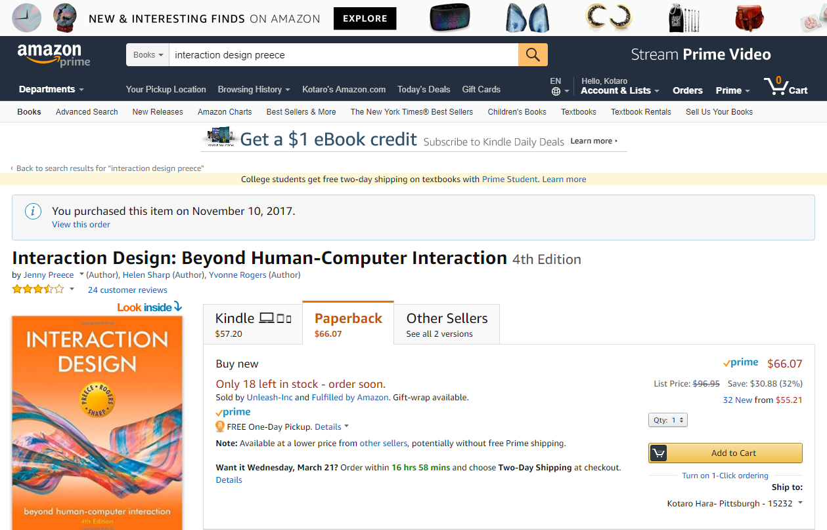
Conversion Rate Exercise
Let’s consider Amazon. What behavioral information of a user could be useful?
Notes:
Let’s consider an example of an ecommerce website. What behavioral information of a user could be useful?

Slide 23
Conversion Rate Exercise

Slide 24

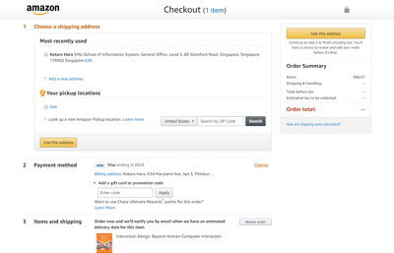
Conversion Rate Exercise
Time
Conversion Rate:
Did the user buy an item, and if not, at what point did they exited?
Which part of the interaction took the longest time?

Slide 25


Sample Population
Strive to Run Experiments at 50%-50%
50% of users to Treatment
50% of users to Control
Assign to Groups at Random
Choose one that gives uniform distribution
Determine the Minimum Sample Size
Detecting the effect of the experiment (or significant change) requires certain number of users
Min sample size shrinks to detect larger differences
Big differences are easier to detect (Cohen’s d)
0.2 difference require 193 users for statistical power of 0.5
0.8 difference requires 13 users for statistical power of 0.5
Notes:
Kohavi et al., (2007) Practical Guide to Controlled Experiments on the Web: Listen to Your Customers not to the HiPPO
https://ai.stanford.edu/~ronnyk/2007GuideControlledExperiments.pdf
http://en.wikipedia.org/wiki/Sample_size_determination
In experimental design, where a study may be divided into different treatment groups, there may be different sample sizes for each group.
Sample sizes may be chosen in several different ways:
using experience – small samples, though sometimes unavoidable, can result in wide confidence intervals and risk of errors in statistical hypothesis testing.
using a target variance for an estimate to be derived from the sample eventually obtained, i.e. if a high precision is required (narrow confidence interval) this translates to a low target variance of the estimator.
using a target for the power of a statistical test to be applied once the sample is collected.
using a confidence level, i.e. the larger the required confidence level, the larger the sample size (given a constant precision requirement).

Slide 26


Detect Big Problems Before they Wreak Havoc
Ramp-up
Start experiment with 0.1% treatment participants
Do simple analysis to detect egregious problems
Ramp up to larger percentage: (Control:Treatment)
99.9%:0.1% to 99.5%:0.5%
90%:10% to 50%:50%
Auto-Abort
Configure system to abort if big “significant” change for the worse is detected
Notes:
https://exp-platform.com/Documents/GuideControlledExperiments.pdf
3.3.1 TreatmentRamp-up
An experiment can be initiated with a small percentage of users assigned to the treatment(s), and then that percentage can be gradually increased. For example, if you plan to run an A/B test at 50%/50%, you might start with a 99.9%/0.1% split, then rampup the Treatment from 0.1% to 0.5% to 2.5% to 10% to 50%. At each step, which could run for, say, a couple of hours, you can analyze the data to make sure there are no egregious problems with the Treatment before exposing it to more users. The square factor in the power formula implies that such errors could be caught quickly on small populations and the experiment can be aborted before many users are exposed to the bad treatment.

Slide 27
Web Experiment
A/B Testing
Web UX Tools
Why do A/B Test?
Why not Hippo?
Examples of design choices
Qualtrics
Loop11
Maze
Designing Test
Different tests
What are control and treatment conditions?
How to decide on design choices?
Understanding test population
Web Analytics
Multivariate Test

Slide 28
Web UX Tools & Web Analytics
SMU Qualtrics (Recommended)
Loop11 (Recommended)
Maze
UserZoom
Helio, UserTesting, Validately, UsabilityHub, Crazy Egg, Userlytics, HotJar, Optimizely, Lookback, TryMyUI, TestRail, Usabilia, ClickTale, OptimalWorkshop
Web Analytics: Google Analytics
Links to these tools and more on the course web site
Notes:
https://www.justinmind.com/blog/usability-testing-tools/
https://uxdesign.cc/a-thorough-review-of-top-user-testing-tools-316625bf8739

Slide 29
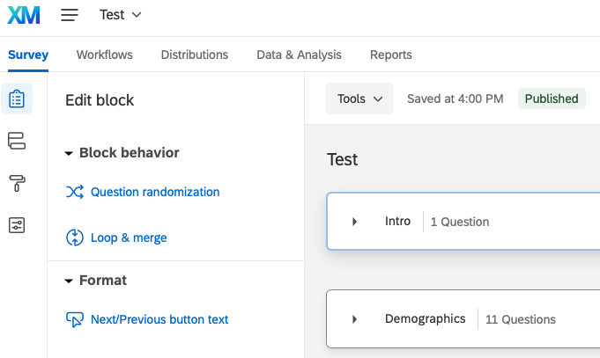
SMU Qualtrics (Recommended)
URL: smusg.asia.qualtrics.com
Test delivery: Web survey
Catalog & Project Templates
CoreXM & DesignXM, CustomerXM, ProductXM, BrandXM
Product Concept Testing – Idea Strength & Weakness
Pricing: free to SMU students (multiple choice)
Task/variable types
General survey responses
Limited ways to measure time

Slide 30
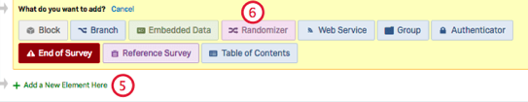
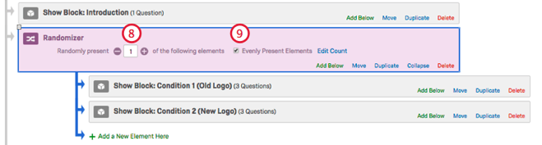
SMU Qualtrics: A/B Testing in Surveys https://www.qualtrics.com/support/survey-platform/common-use-cases-rc/a-b-testing/
Add block, condition and navigate to Survey flow
Add New Element: Randomizer
Move condition under Randomizer
Present 1 and check Evenly Present Elements
Notes:
https://www.qualtrics.com/support/survey-platform/common-use-cases-rc/a-b-testing/ A/B Testing can be performed in Qualtrics by randomly assigning respondents to one of the two (or more) conditions, without letting the respondents know what the other condition looks like. This allows respondents to provide opinions unbiased by the desire to compare and contrast options. https://www.qualtrics.com/support/survey-platform/survey-module/survey-flow/standard-elements/randomizer/ With a randomizer in your survey flow, you can randomly present question blocks, embedded data, and other survey flow elements to your respondents When selected, “Evenly Present Elements” makes sure that even as elements are randomized, they are randomized evenly. This setting keeps careful watch on the counts to ensure every element is presented an equal number of times. In addition to blocks, you can use the randomizer to randomize other elements in the survey flow. For example, you can use a randomizer to randomly assign specific embedded data labels to each respondent or to randomly send your respondents to different survey endings with end of survey elements

Slide 31
Loop11 (Recommended)
URL: www.loop11.com
Test delivery: Online Usability, A/B, User, Mobile testing
Pricing: 14-day free trial (run 3 tests)
Academic License (sign up with SMU account): Loop11 Enterprise subscription
Task/variable types
Perform task on web app
Task completion rate
Time per task
Most common success page, fail page, first click
Comprehensive user testing analysis
Detailed participant path analysis
Number of page views to complete tasks
Video, audio and screen recording
Notes:
https://www.loop11.com/how-loop11-works/

Slide 32
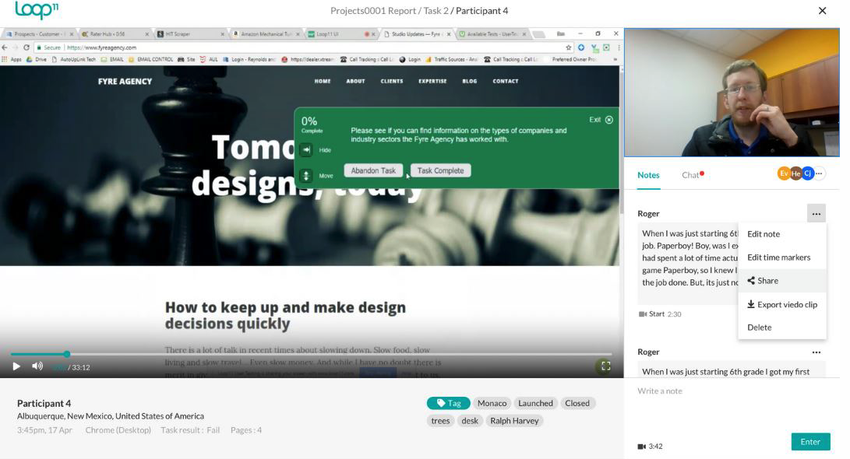
Loop11
Actual web site
Task to perform
Notes:
https://www.g2.com/products/loop11/reviews
https://www.loop11.com/how-loop11-works/
https://www.loop11.com/everything-you-need-to-know-about-a-b-testing/

Slide 33
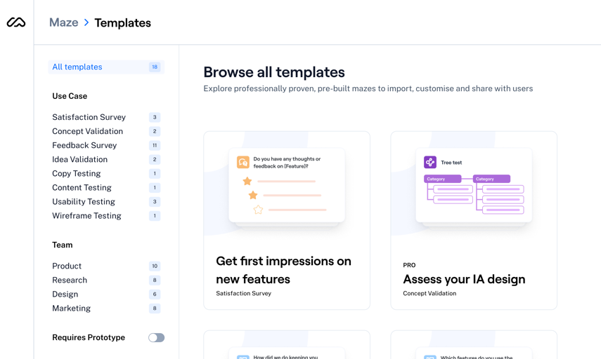
Maze (Gaining Popularity –Ease of use)
URL: https://maze.co
Test delivery: Web survey, Wireframe
Wireframe and usability testing
Import Adobe XD, Figma, InVision, Marvel prototype
Free Trial: 3 active projects, 10 blocks, Teams
Blocks: Mission (path), Open Question, Multiple Choice, Opinion Scale, Yes/No, Context Screen (image), Tree Test (navigate)
Video Tutorial
A/B Testing
Notes:
https://help.maze.co/hc/en-us
https://help.maze.co/hc/en-us/articles/360052722793-Getting-started-with-Maze
https://help.maze.co/hc/en-us/articles/360051963334-A-B-testing-or-split-testing-your-prototypes-with-Maze

Slide 34
UserZoom
URL: https://www.userzoom.com
Test delivery: Web survey, usability
UX researcher, designer, product manager, marketers
Think out load video, survey, live intercept, click test
Free Trial: 14 day, no CC
UserZoom
University (login) https://www.usertesting.com/resources/learn
Resource center https://www.usertesting.com/resource-library

Slide 35
Web Experiment
A/B Testing
Web UX Tools
Why do A/B Test?
Why not Hippo?
Examples of design choices
Qualtrics
Loop11
Maze
Designing Test
Different tests
What are control and treatment conditions?
How to decide on design choices?
Understanding test population
Web Analytics
Multivariate Test

Slide 36
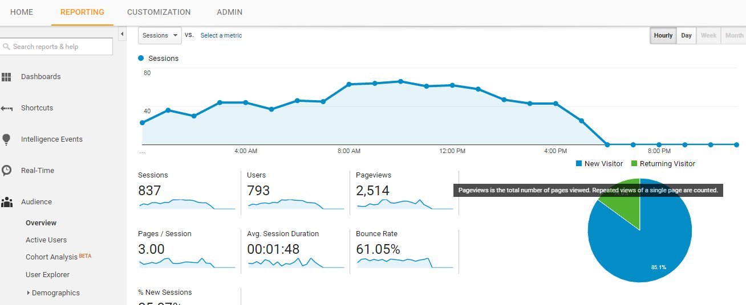
Web Analytics
Analytics is a method for evaluating user traffic through a system. When used to examine traffic on a website or part of a website, the analytics are known as web analytics.
Web analytics data tracks users’ behaviour closely, such as how long people stay on a web page, where they spend most of their time, which other sites they came from, what adverts they looked at and for how long.
For example, Google Analytics, Adobe Analytics, Open Web Analytics
Notes:
Preece et al., (2015) Interaction Design, p.264 and p.514

Slide 37

How to get Valuable Insights (IS211 Project)
Focus on an important
part of the problem Or the first breakdown
Not the entire prototype
May be on one screen/view
Or on navigation style
Not be too many independent changes between A and B
Not obvious which is better
Compare two good alternatives
Make a fair test between conditions
Make tasks realistic

Slide 38

A/B Testing vs Multivariate Testing
Both methods test design variations against each other by dividing live site (or application) traffic across variations
A/B test: two different UI design
Multivariate: every combination of UI design choices
manipulating a small set of variables. Different layouts, different copy, different navigation, different visual design, and so on.
more traffic is typically required to run a multivariate test
all combinations of the variants must make sense together
Notes:
https://www.youtube.com/watch?v=fp6UWlZm1jk 0:00-2:47
NNgroup A/B Testing vs. Multivariate Testing for Design Optimization
https://www.nngroup.com/articles/multivariate-testing/
Both methods test design variations against each other by dividing live site (or application) traffic across variations.
Both measure which design alternative (i.e., variation) leads to the highest rate of conversions for specified goals.
In an A/B test, the variations being tested could be completely different from each other, and not the result of manipulating a small set of variables. For instance, you could have two pages with completely different layouts, different copy, different navigation, different visual design, and so on. The result of the A/B test will indicate that one variation performs better than the other, but you will not know whether it’s because your copy is better, your visual design is better, or your layout is better (or the combination).
more traffic is typically required to run a multivariate test
all combinations of the variants must make sense together

Slide 39
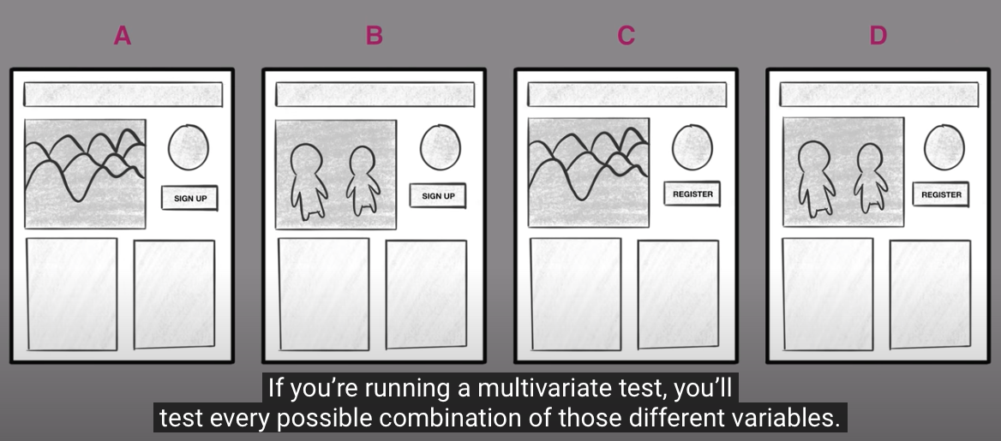
A/B Testing vs. Multivariate Testing for Design Optimization https://www.youtube.com/watch?v=fp6UWlZm1jk
Multivariate testing can determine what change or combination of changes will have the greatest impact
Notes:
https://www.youtube.com/watch?v=fp6UWlZm1jk 0:00-2:47
NNgroup A/B Testing vs. Multivariate Testing for Design Optimization

Slide 40

Web Experiment Exercise (1)
Choose one goal (A/B) for your A/B testing
Which screen/page/view/navigation will you compare?
An important view, not many changes, not obvious
What data will you collect?
Success metric/conversion rate
Choose a task for user to perform
List a task “Search for ‘Spider Man’” specific to the success metric/data you collect
Participants:
Who will you recruit? Characteristics?
Environment: Choose the tool(s) you will use
Qualtrics, Loop11, Maze

Slide 41
Summary
A/B Testing Principles
Small changes, big impact
Hippo vs Data trumps intuition
Randomized controlled experiment
Concepts
Control condition vs. Treatment condition
Valuable insights
Conversion rate
Sample population
Random assignment with minimum size
Ramp-up and auto-abort
Web Analytics
Multi variate Testing
Tools
SMU Qualtrics
Loop11
Maze
UserZoom

Slide 42
Readings
Recommended
Preece et al, Interaction Design 5th
8.6 (Observation)
16.3 (Analytics and A/B Testing)
Supplementary
Kohavi, Henne, and Sommerfield. Practical guide to controlled experiments on the web.

